Slide 1

FIN
Friend in need

Slide 2
Group Members
S. M. Tasnimul Hasan (180204142)
Md Zahidul Haque(180204136)
Sanjida Aziz Tonny (180204122)
Fazlay Elahi Safin (180204119)
KH. Rifat amin (180204116)

Slide 3

FIN (Friend in need)
It’s an Android Application
It will contain emergency services (such as Medical Service, Ambulance Service, Fire Service, Blood bank etc.)
The app will fetch Our current location and redirect us to the nearest emergency service
Some services will be available to work without internet
We will create a Blood group database for AUST students

Slide 4




Development tools
Java
Android studio
Firebase Database
A team of five people

Slide 5
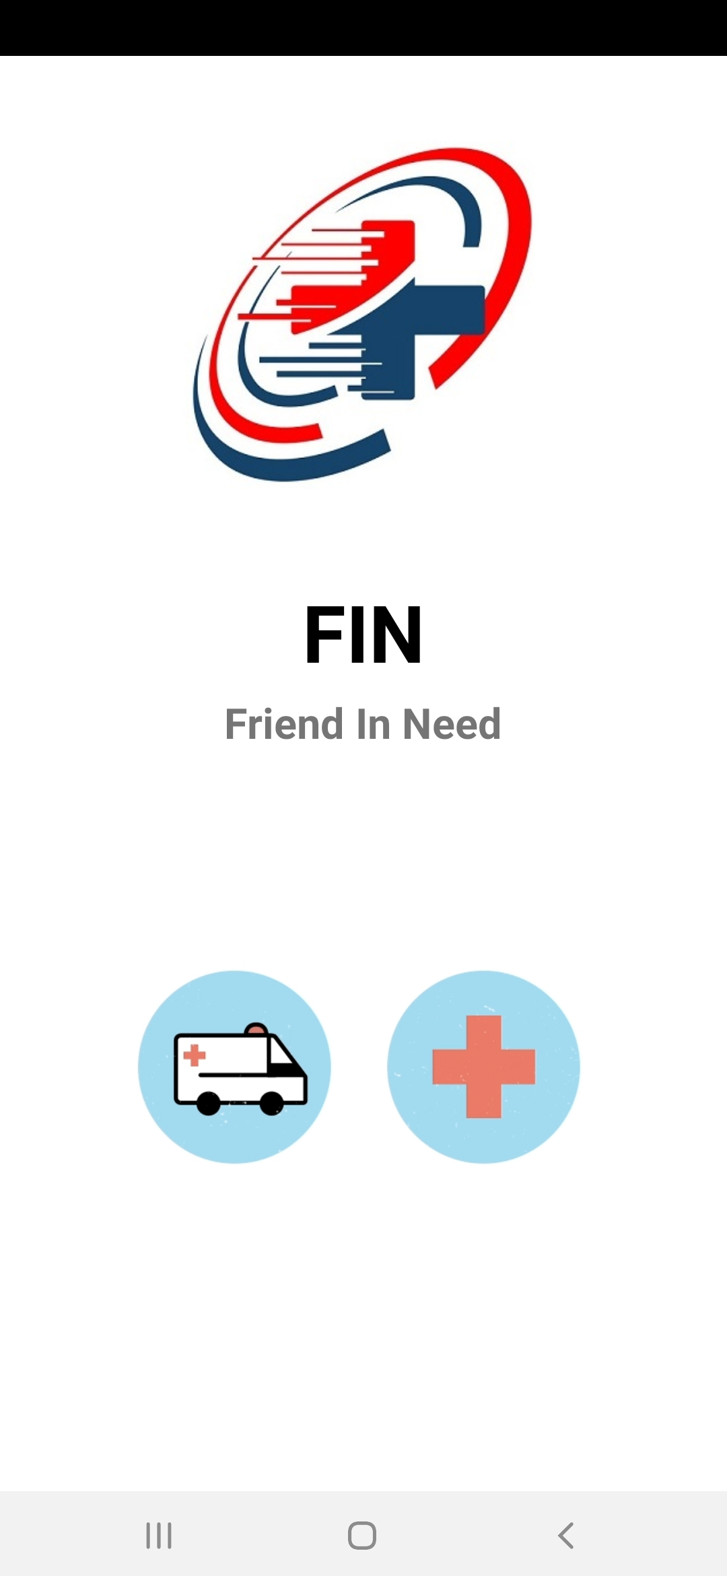
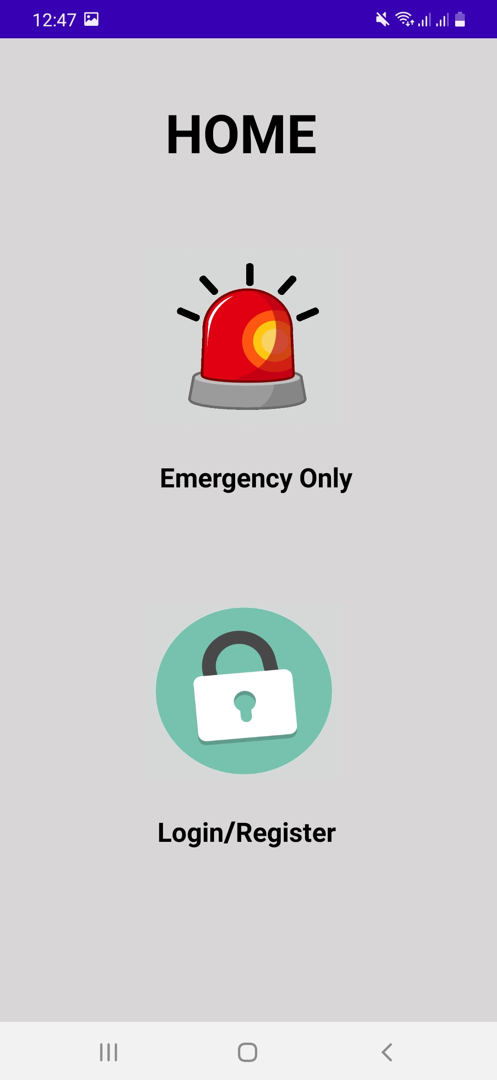
Pages

Slide 6
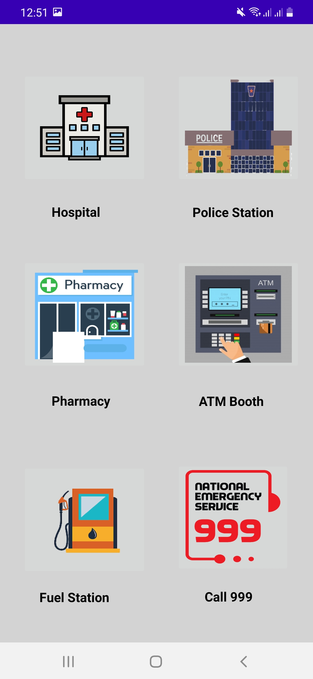
Emergency Only section
Hospital
Police Station
Pharmacy
ATM Booth
Fuel Station
Call 999

Slide 7
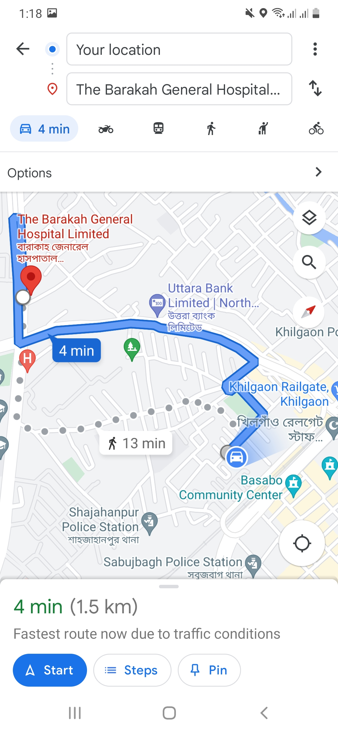
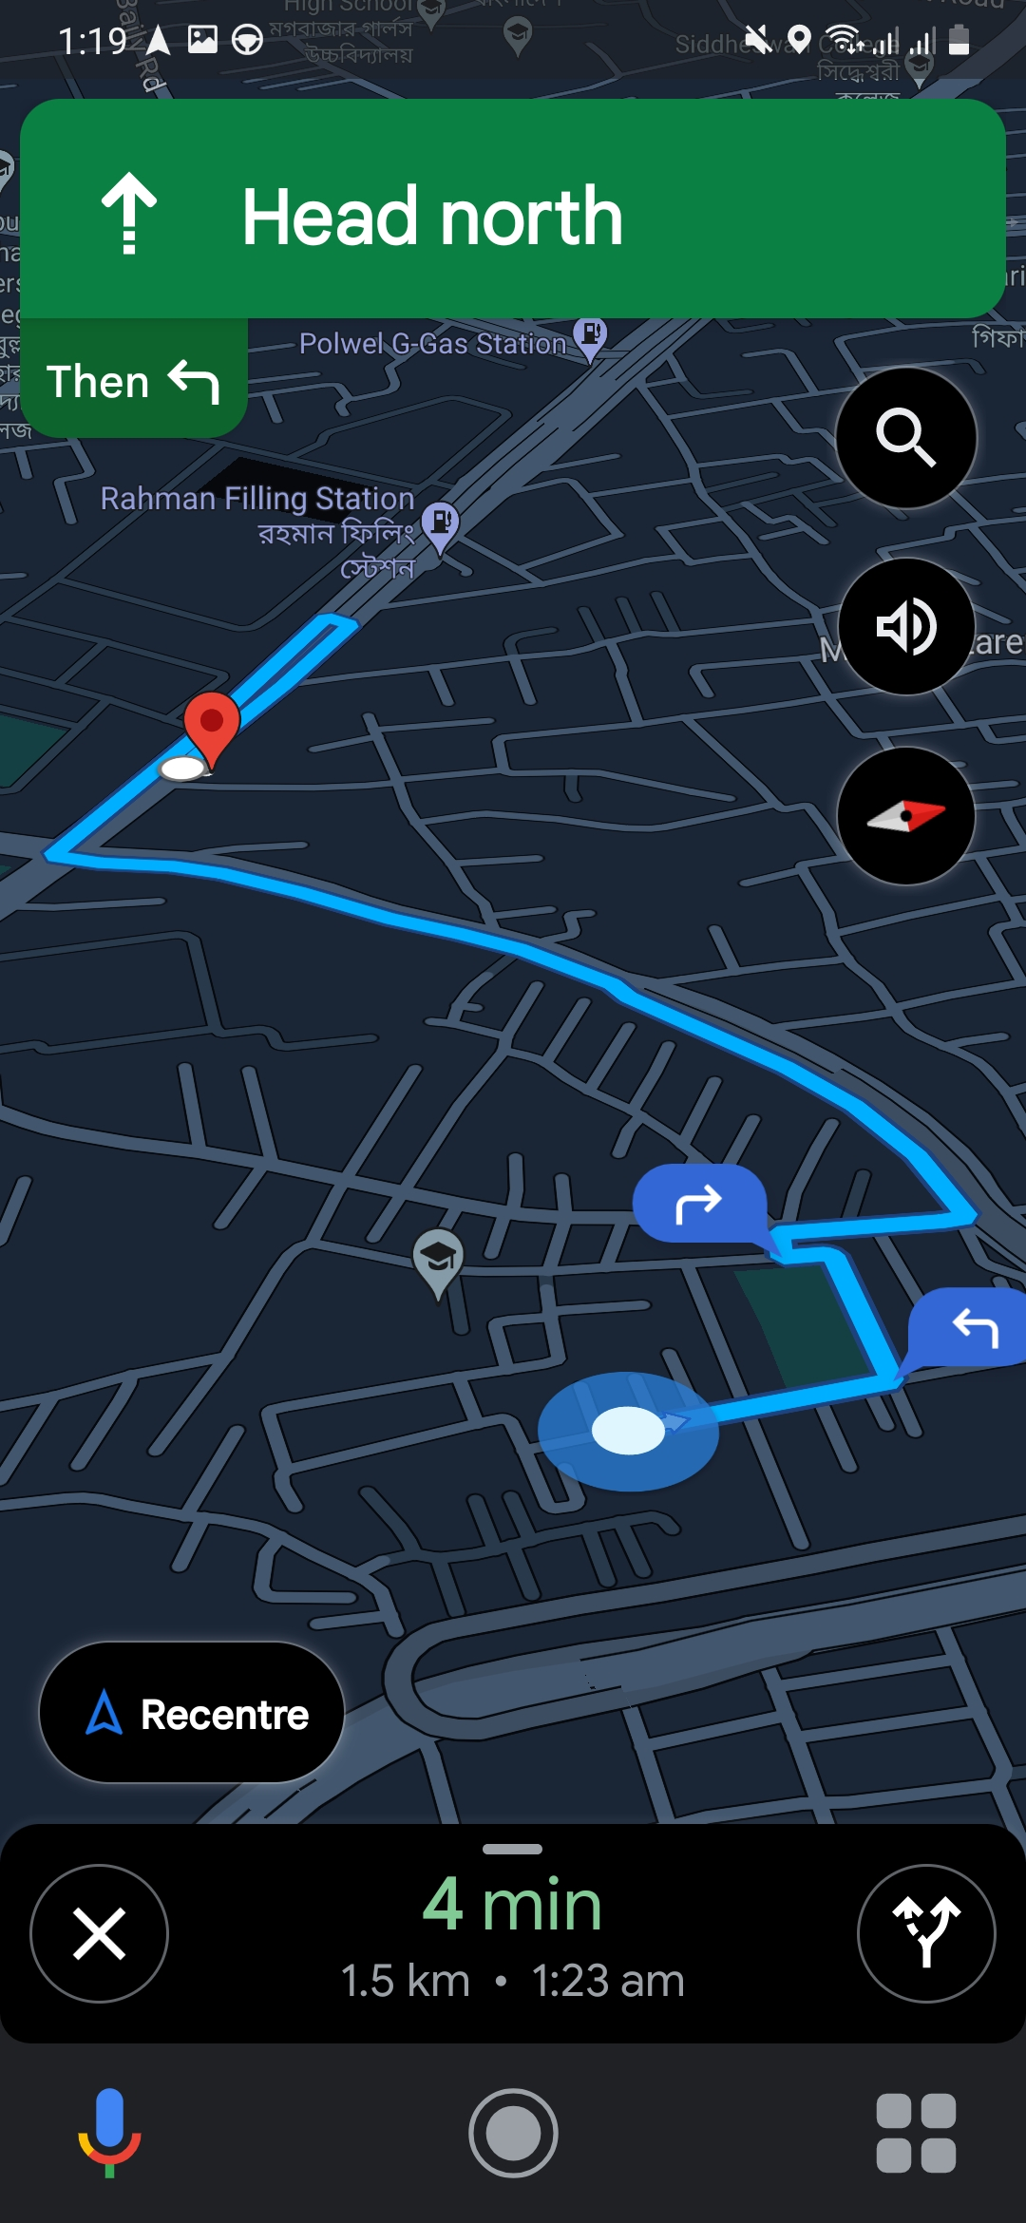
Emergency Only section

Slide 8
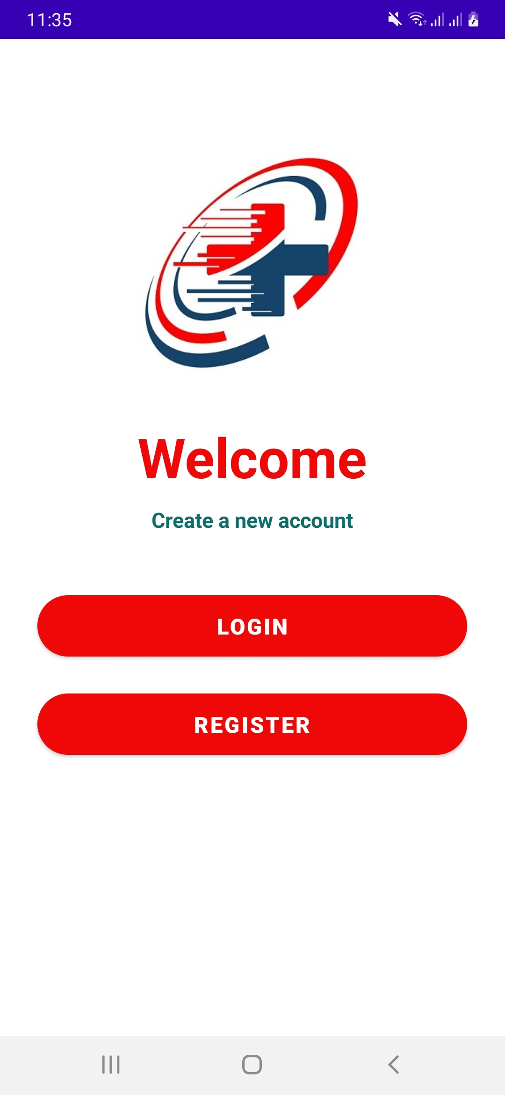
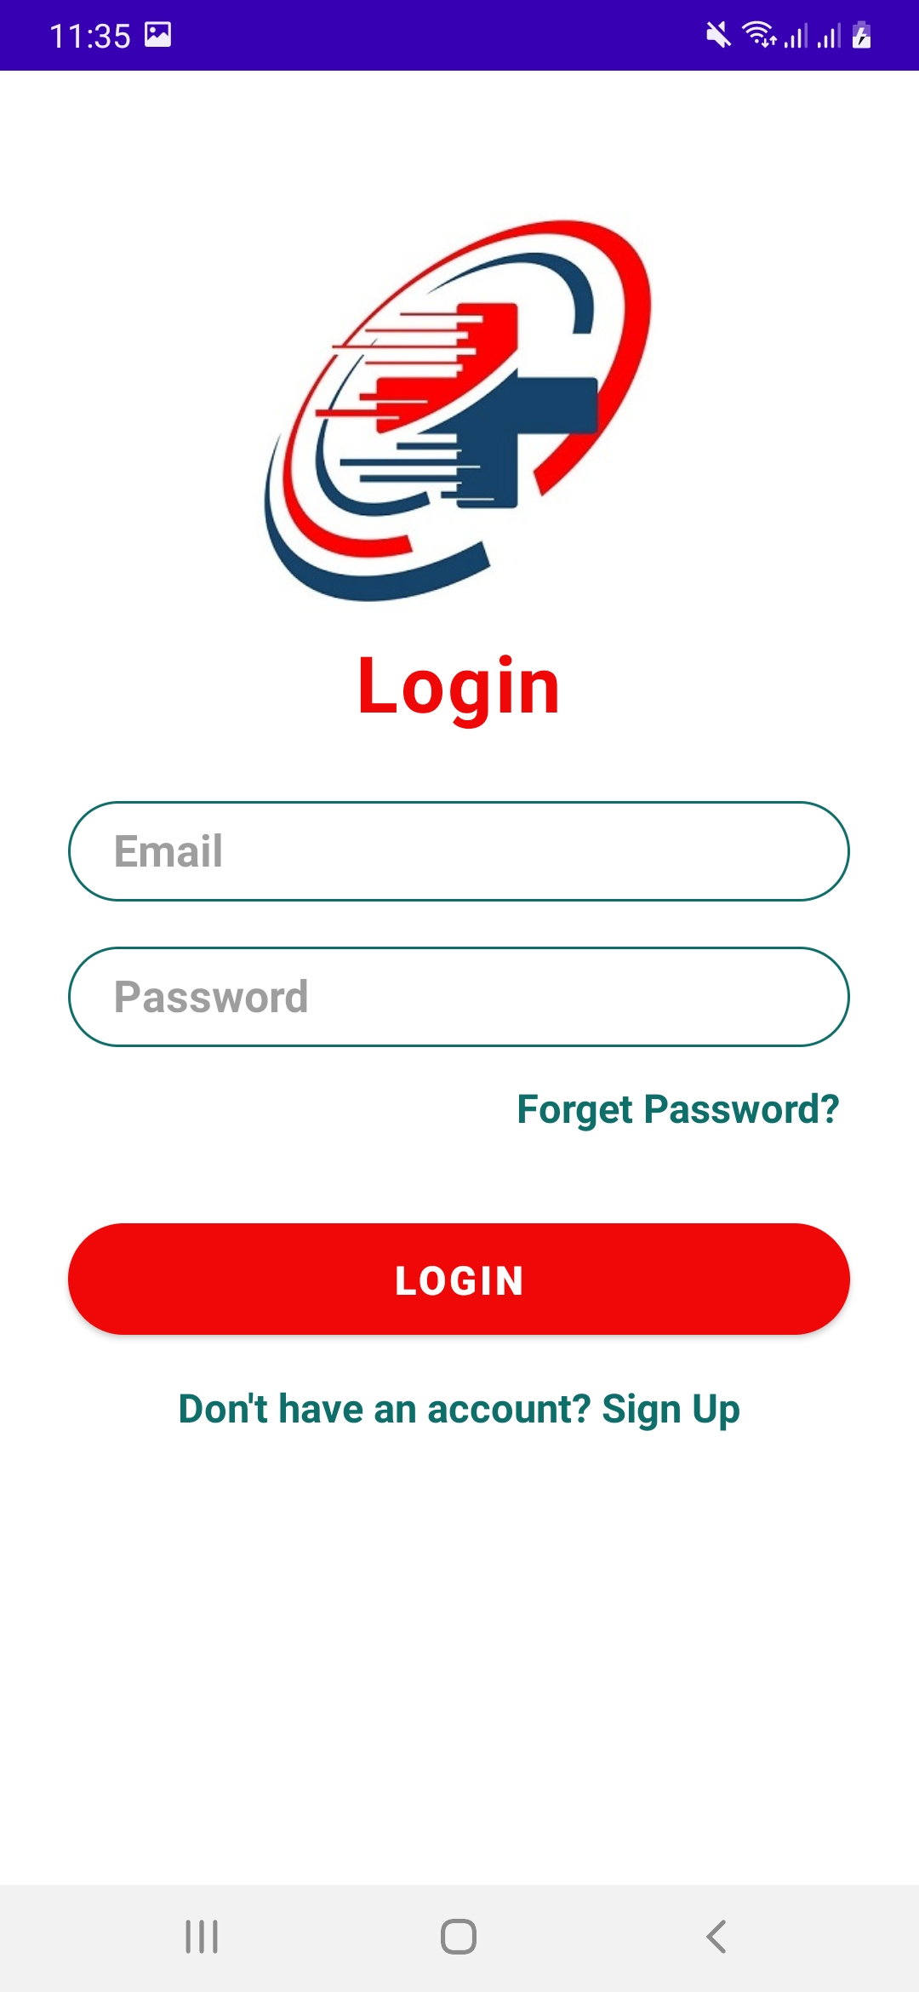
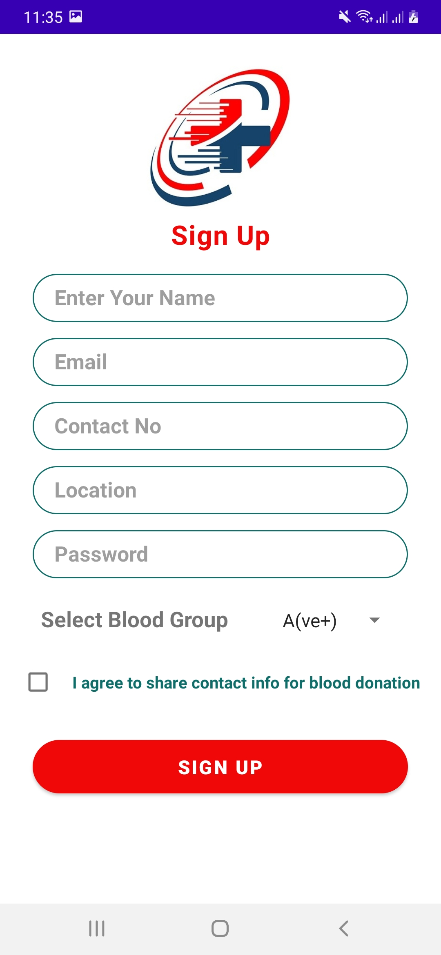

Login & Register

Slide 9
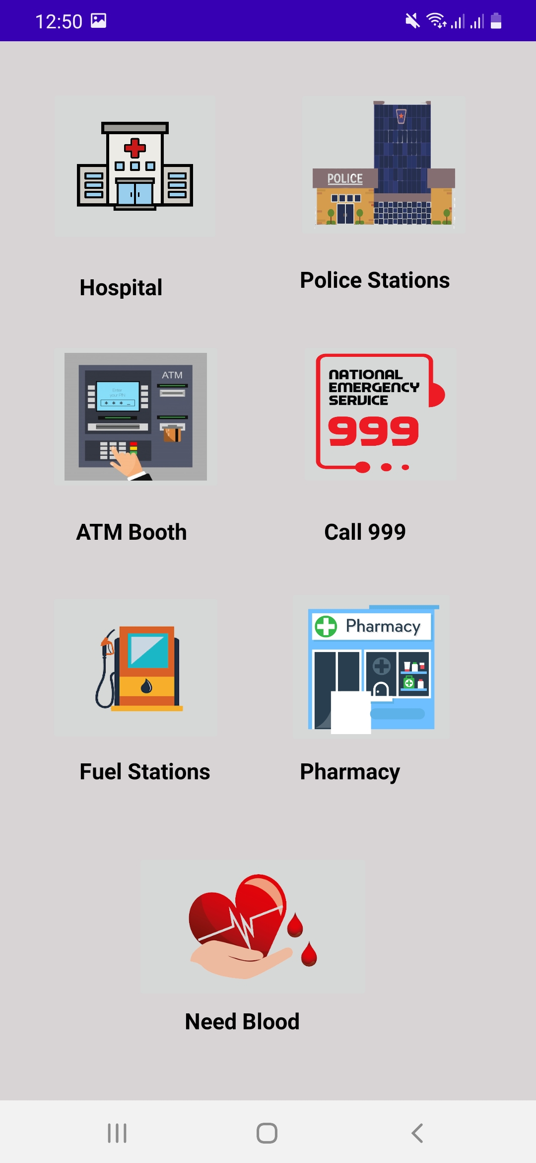
After Login
After login users can access Blood Bank
Users also can see nearby all the hospitals, police stations, pharmacies etc.

Slide 10
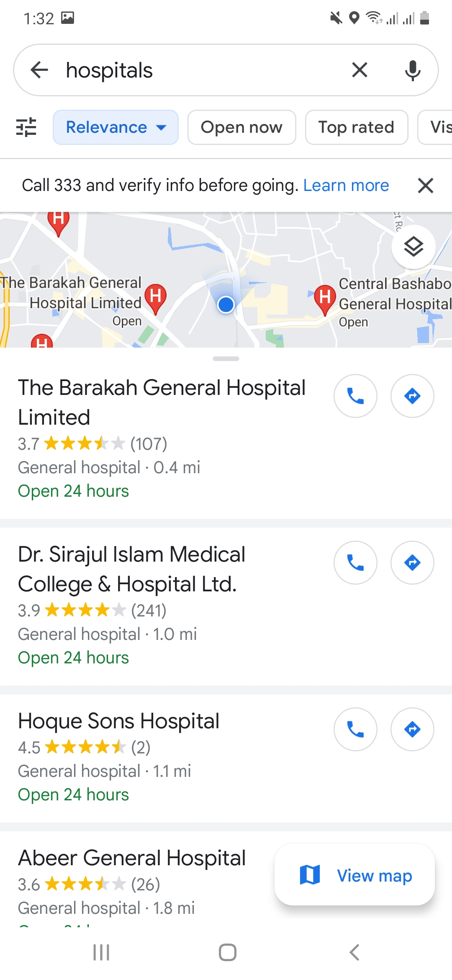
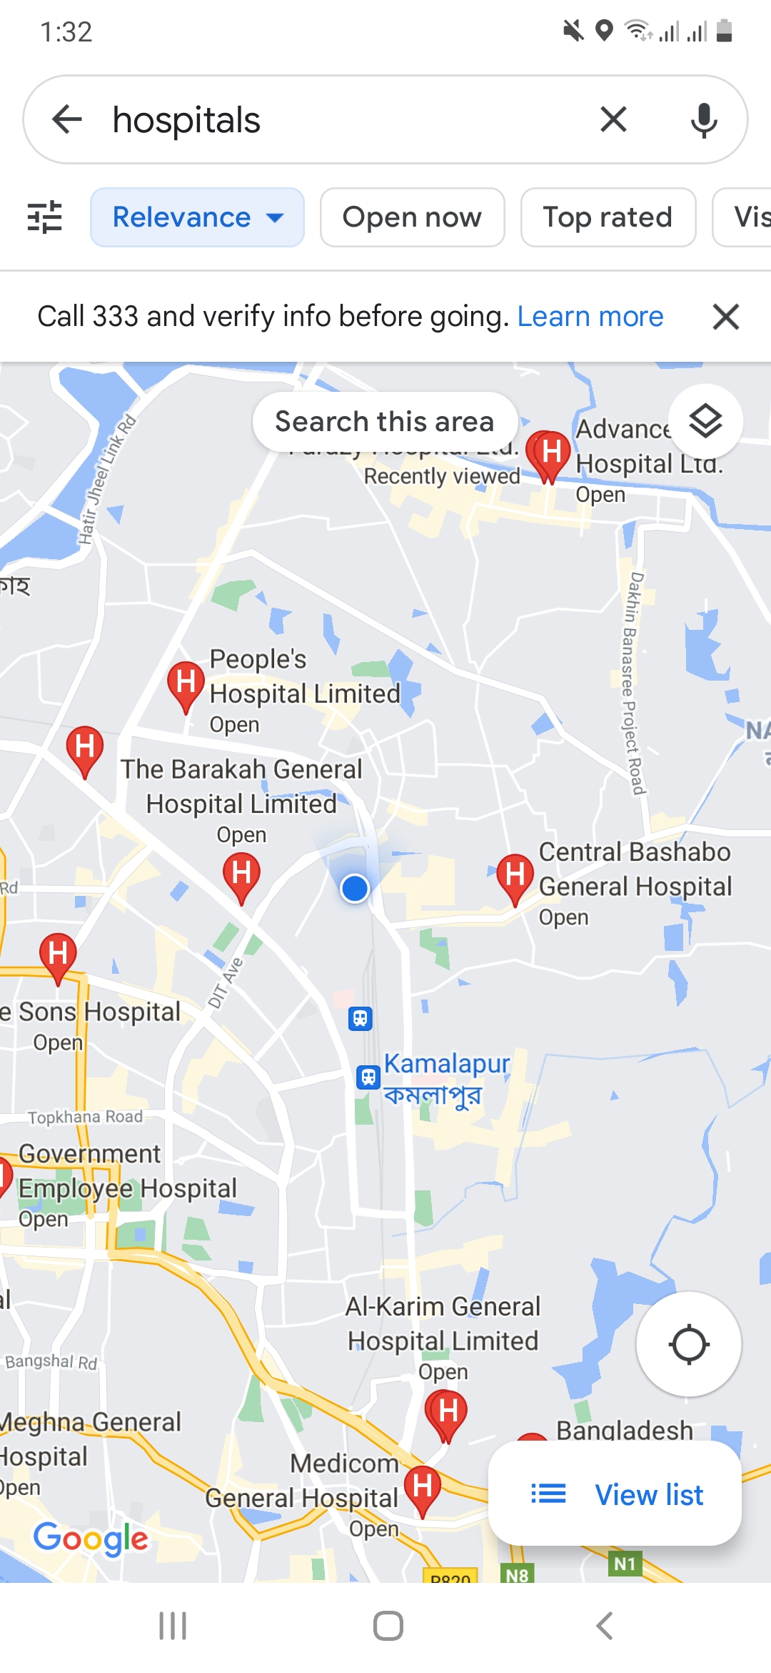
After Login

Slide 11

Future developments
User Profile Section
Navigation Bar
Get & Send Locations via message on emergency situations
About Us Page
Password Recovery Option

Slide 12

Thank You

